Slide 1
Unit 1 – Overview of OS

Slide 2
Computer System
Introduction to OS
Two Views/aspects of OS
Evolution/History of OS
Types of OS
Structure of OS
System Calls
Handling System Calls
Types of System Calls
The Shell
Open Source OS

Slide 3
Computer System
Computer system can be divided into four components:
Hardware – provides basic computing resources
CPU, memory, I/O devices
Operating system
Controls and coordinates use of hardware among various applications and users
Application programs – define the ways in which the system resources are used to solve the computing problems of the users
Word processors, compilers, web browsers, database systems, video games
Users
People, machines, other computers

Slide 4

Computer System (contd.)
Four Components of a Computer System

Slide 5
Operating System
A program that acts as an intermediary between a user of a computer and the computer hardware.
Operating system goals:
Execute user programs and make solving user problems easier
Make the computer system convenient to use
Use the computer hardware in an efficient manner

Slide 6
Aspects of OS
OS is a resource manager
Manages all resources
Decides between conflicting requests for efficient and fair resource use
OS is a extended machine
Controls execution of programs to prevent errors and improper use of the computer.
Hides the complexity of the hardware and present simple and nice view to user.

Slide 7
Evolution of OS
First Generation Computers (1945-55)
Vacuum-tubes as building machine
Single group of people designed, built, programmed, operated and maintained each machine
Machine Code is used
OS and programming language were unknown
Second Generation Computers (1955-65)
Transistors as building machine
Batch System were used
FORTAN and assembly language were used

Slide 8
Evolution of OS (contd.)
Third Generation Computers (1965-80)
Integrated Circuit (IC) as building machine
Multiprogramming came into existence
OS: OS/360, MULTICS, CTSS were used
Fourth Generation of Computers (1980-Present)
LSI and VLSI as building machine
Microcomputers came into existence
IBM PC (MS-DOS), Apple Macintosh (Macintosh)

Slide 9
Types of OS
Mainframe OS
Server OS
Multiprocessor OS
PC OS
Real time OS
and so on ...

Slide 10
Types of OS (contd.)
Mainframe OS
Capable of processing large amounts of information and supporting a great number of users
Used generally in support of government and business projects
Server OS
Developed for multi-user computer programs, programs important for business computing and networked application

Slide 11
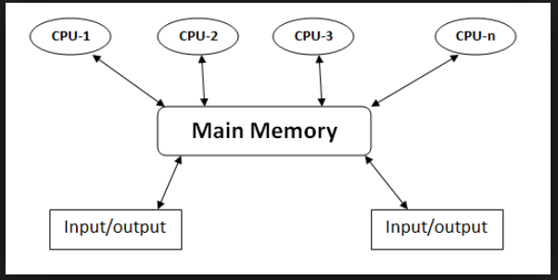
Types of OS (contd.)
Multiprocessor OS
Within a single computer system, the usage of multiple central processing units (CPUs) is known as multiprocessor operating system. Such systems are used to process large volumes of data at a very high speed.

Slide 12
Types of OS (contd.)
Personal Computer (PC) OS
An operating system serving the general purpose (word processing, spreadsheets, web browser, digital media and others) of the end user is known as a personal computer operating system
Real Time OS
The operating systems for serving real time application requests is known as real time operating systems
The real time operating system should be capable of responding and serving requests as and when they come in

Slide 13
Structure of OS
Multiprogramming (Batch system) needed for efficiency
Single user cannot keep CPU and I/O devices busy at all times
Multiprogramming organizes jobs (code and data) so CPU always has one to execute
A subset of total jobs in system is kept in memory
One job selected and run via job scheduling
When it has to wait (for I/O for example), OS switches to another job
Timesharing (multitasking) is logical extension in which CPU switches jobs so frequently that users can interact with each job while it is running, creating interactive computing
Response time should be < 1 second
Each user has at least one program executing in memory process
If several jobs ready to run at the same time  CPU scheduling
If processes don’t fit in memory, swapping moves them in and out to run
Virtual memory allows execution of processes not completely in memory

Slide 14
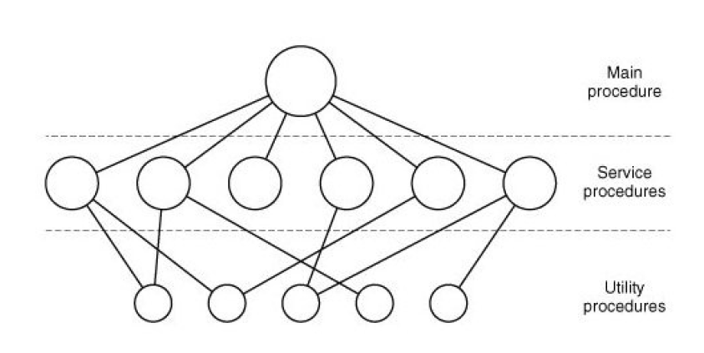
Structure of OS (contd.)
Monolithic Structure
The components of monolithic operating system are organized haphazardly and any module can call any other module without any reservation.
Similar to the other operating systems, applications in monolithic OS are separated from the operating system itself. That is, the operating system code runs in a privileged processor mode (referred to as kernel mode), with access to system data and to the hardware.
applications run in a non-privileged processor mode (called the user mode), with a limited set of interfaces available and with limited access to system data.
The monolithic operating system structure with separate user and kernel processor mode is shown in Figure.
The structure is that there is no structure. The operating system is written as a collection of procedures, each of which can call any of the other ones whenever it needs to.
Examples: CP/M and MS-DOS

Slide 15
Structure of OS (contd.)
Layered Systems (Simple Structure)
The layered approach consists of breaking the operating system into the number of layers(level), each built on the top of lower layers. The bottom layer (layer 0) is the hardware layer; the highest layer is theuser interface.
The main advantages of the layered approach is modularity.
Example Systems: VAX/VMS, Multics, UNIX
Layer | Functions
5 | The operator
4 | User Programs
3 | Input/Output Management
2 | Operator-process communication
1 | Memory and drum management
0 | Processor allocation and multiprogramming

Slide 16
Structure of OS (contd.)
Microkernels
Client-Server Model
Virtual Machines
Exo-Kernels

Slide 17
System Calls
A way of programs to interact with the OS
Programmatic way to request a service from the kernel of the OS it is executed on
Services Provided by System Calls :
Process creation and management
Main memory management
File Access, Directory and File system management
Device handling(I/O)
Protection
Networking, etc.

Slide 18
System Calls (contd.)
TYPES | WINDOWS | UNIX
Process Control | CreateProcess() ExitProcess() WaitForSingleObject() | fork() exit() wait()
File Manipulation | CreateFile() ReadFile() WriteFile() CloseHandle() | open() read() write() close()
Device Manipulation | SetConsoleMode() ReadConsole() WriteConsole() | ioctl() read() write()
Information Maintenance | GetCurrentProcessID() SetTimer() Sleep() | getpid() alarm() sleep()
Communication | CreatePipe() CreateFileMapping() MapViewOfFile() | CreatePipe() CreateFileMapping() MapViewOfFile()
Protection | SetFileSecurity() InitlializeSecurityDescriptor() SetSecurityDescriptorGroup() | chmod() umask() chown()

Slide 19
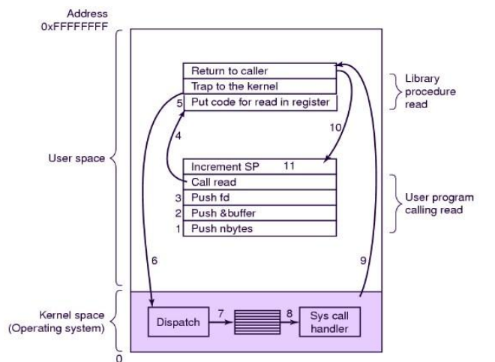
Handling System Calls

Slide 20
Handling System Calls (contd.)
System calls performed in a series of steps. Most of the system calls are invoked as the following example system call: read
count = read(fd, buffer, nbytes)
Push parameters into the stack (1-3)
Calls library procedure (4)
Pass parameters in registers.(5)
Switch from user mode to kernel mode and start to execute.(6)
Examines the system call number and then dispatches to the correct system call handler via a table of pointer.(7)
Runs system call handlers (8).
Once the system call handler completed its work, control return to the library procedure.(9)
This procedure then return to the user program in the usual way. (10)
Increments Stack Pointer (SP) before call to finish the job. (11)

Slide 21
The Shell
The outermost layer in an operating system
A computer application software that provides the services of an operating system to an external user or another program
Shell may be off either CLI or GUI
Executes programs based on the input provided by the user

Slide 22
Open Source Operating System
Operating systems made available in source-code format rather than just binary closed-source
Counter to the copy protection and Digital Rights Management (DRM) movement
Started by Free Software Foundation (FSF), which has “copyleft” GNU Public License (GPL)
Examples include GNU/Linux and BSD UNIX (including core of Mac OS X), and many more
Can use VMM like VMware Player (Free on Windows), Virtualbox (open source and free on many platforms - http://www.virtualbox.com)
Use to run guest operating systems for exploration

Slide 23
What OS Do
Depends on the point of view
Users want convenience, ease of use, and good performance
Don’t care about resource utilization
But shared computers such as mainframe or minicomputers must keep all users happy
Users of dedicated systems such as workstations have dedicated resources but frequently use shared resources from servers
Handheld computers are resource-poor, optimized for usability and battery life
Some computers have little or no user interface, such as embedded computers in devices and automobiles

Slide 24
System Program
System programs provide a convenient environment for program development and execution. They can be divided into:
File manipulation
Status information is sometimes stored in a File modification
Programming language support
Program loading and execution
Communications
Background services
Application programs

Slide 25
Common OS Concepts
Process Management
Memory Management
File System Management

Slide 26
Process Management
A process is a program in execution. It is a unit of work within the system. Program is a passive entity, process is an active entity.
Process needs resources to accomplish its task
CPU, memory, I/O, files
Initialization data
Process termination requires reclaim of any reusable resources
Single-threaded process has one program counter specifying location of next instruction to execute
Process executes instructions sequentially, one at a time, until completion
Multi-threaded process has one program counter per thread
Typically system has many processes, some user, some operating system running concurrently on one or more CPUs
Concurrency by multiplexing the CPUs among the processes / threads

Slide 27
Memory Management
To execute a program all (or part) of the instructions must be in memory
All (or part) of the data that is needed by the program must be in memory.
Memory management determines what is in memory and when
Optimizing CPU utilization and computer response to users
Memory management activities
Keeping track of which parts of memory are currently being used and by whom
Deciding which processes (or parts thereof) and data to move into and out of memory
Allocating and deallocating memory space as needed

Slide 28
Storage Management
OS provides uniform, logical view of information storage
Abstracts physical properties to logical storage unit - file
Each medium is controlled by device (i.e., disk drive, tape drive)
Varying properties include access speed, capacity, data-transfer rate, access method (sequential or random)

Slide 29
File-System Management
Files usually organized into directories
Access control on most systems to determine who can access what
OS activities include
Creating and deleting files and directories
Primitives to manipulate files and directories
Mapping files onto secondary storage
Backup files onto stable (non-volatile) storage media

Slide 30
Mass-Storage Management
Usually disks used to store data that does not fit in main memory or data that must be kept for a “long” period of time
Proper management is of central importance
Entire speed of computer operation hinges on disk subsystem and its algorithms
OS activities
Free-space management
Storage allocation
Disk scheduling
Some storage need not be fast
Tertiary storage includes optical storage, magnetic tape
Still must be managed – by OS or applications
Varies between WORM (write-once, read-many-times) and RW (read-write)

